Slide 1

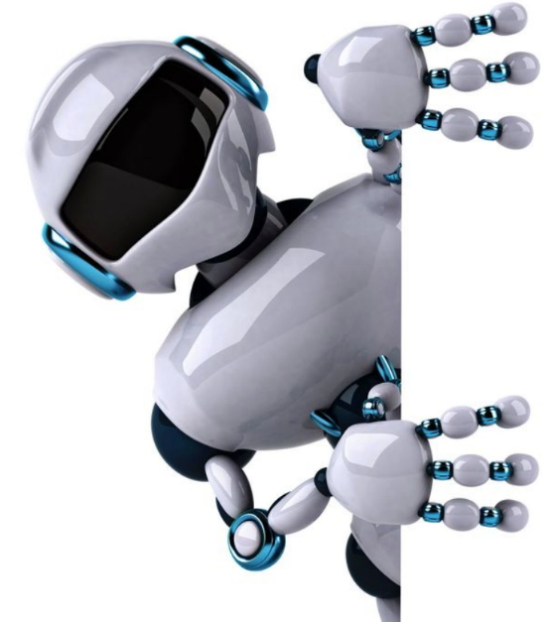
Machine Learning
Reinforcement Learning

Slide 2
Reinforcement learning (RL)
RL is a type of machine learning where an agent learns to make decisions in an environment to maximize a reward signal. It's like teaching a computer to learn through trial and error, mimicking how humans learn by experiencing the consequences of their actions.

Slide 3
Key Concepts:
Agent: The entity (e.g., a software program, robot) that learns and takes actions in the environment.
Environment: The external world where the agent interacts.
Action: The choices the agent makes to interact with the environment.
State: The current situation or condition of the environment.
Reward: A positive or negative feedback signal that tells the agent how good or bad its actions were.
Policy: The strategy the agent uses to choose actions in different situations.

Slide 4
How it Works:
The agent interacts with the environment, taking actions based on its current policy.
The environment responds to the agent's actions, providing the agent with a new state and a reward.
The agent uses the reward to update its policy, learning which actions lead to better outcomes.
This process repeats, with the agent gradually learning an optimal policy that maximizes the cumulative reward over time.

Slide 5
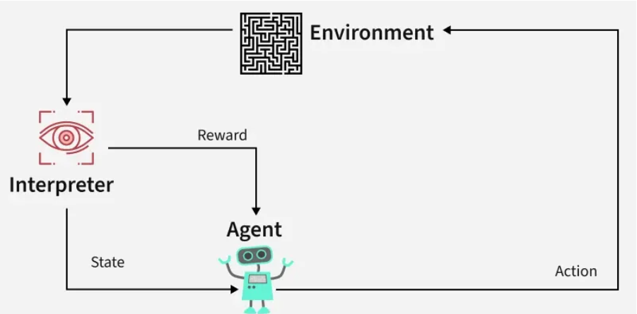
https://www.geeksforgeeks.org/what-is-reinforcement-learning/

Slide 6
Example:
Imagine training an agent to control a robot in a factory. The agent would:
Perceive its current state (e.g., location, orientation, object in hand).
Choose an action (e.g., move forward, rotate, grasp an object).
Receive a reward (e.g., +1 for completing a task, -1 for crashing into something).
Adjust its policy to learn how to perform the tasks efficiently and avoid negative consequences.

Slide 7
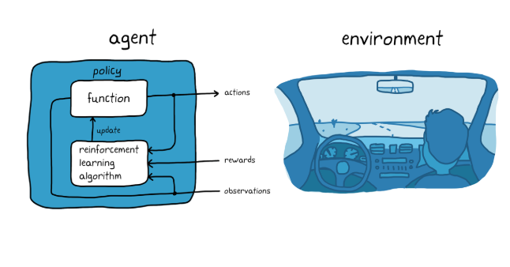
https://www.mathworks.com/discovery/reinforcement-learning.html

Slide 8
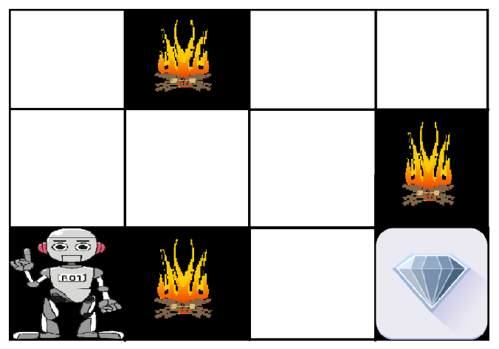
https://www.geeksforgeeks.org/what-is-reinforcement-learning/

Slide 9
Benefits of Reinforcement Learning
Autonomous Learning—RL allows agents to learn without explicit instructions, making them adaptable to new environments.
Optimal Decision Making—RL aims to find the best actions to achieve a desired goal, even in complex situations.
Delayed Gratification—RL algorithms can learn to prioritize long-term rewards over immediate ones.

Slide 10
Applications of Reinforcement Learning:
Robotics: Training robots to perform tasks, navigate, and interact with their environment.
Game Playing: Developing AI agents that can play games like chess, Go, and even complex video games.
Recommendation Systems: Personalizing recommendations based on user behavior.
Traffic Management: Optimizing traffic flow in cities.
Financial Modeling: Developing algorithms for trading and portfolio management.

Slide 11
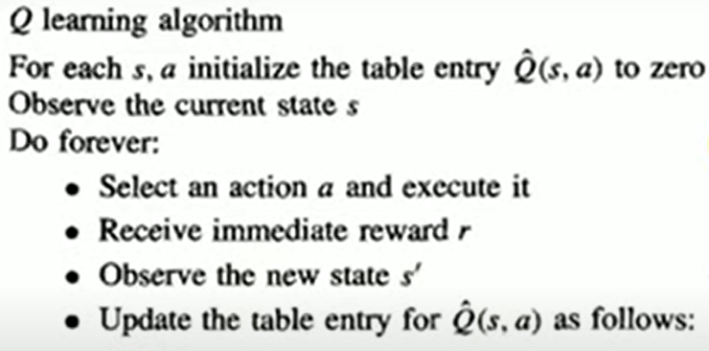
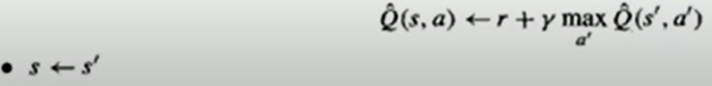

Slide 12
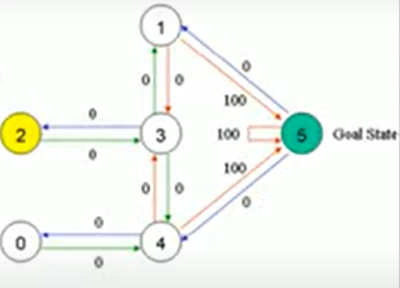

Slide 13
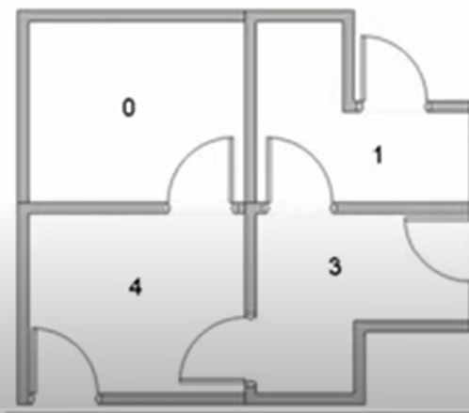
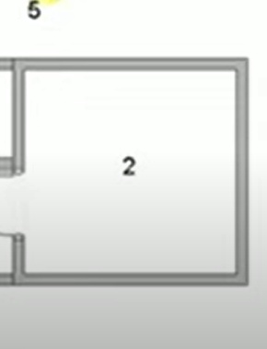

Slide 14
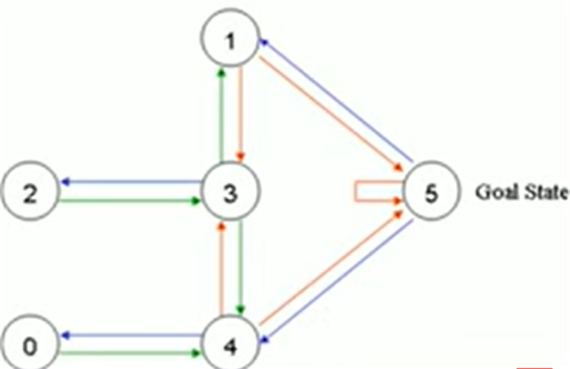

Slide 15
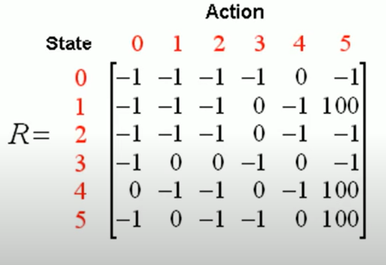

Slide 16
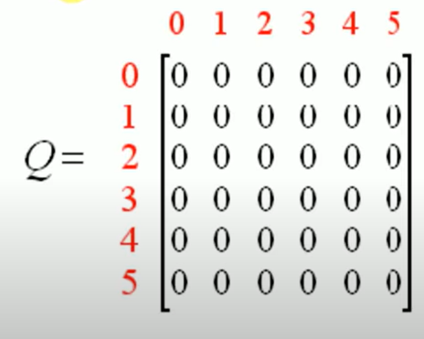

Slide 17
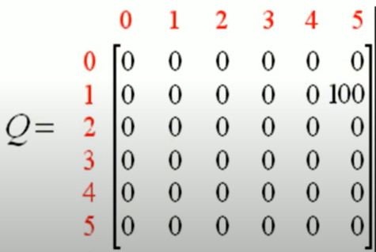

Slide 18
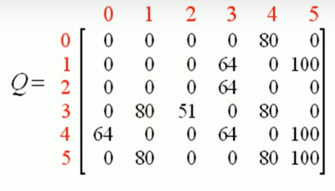
Final Matrix:

Slide 19
